Slide 1


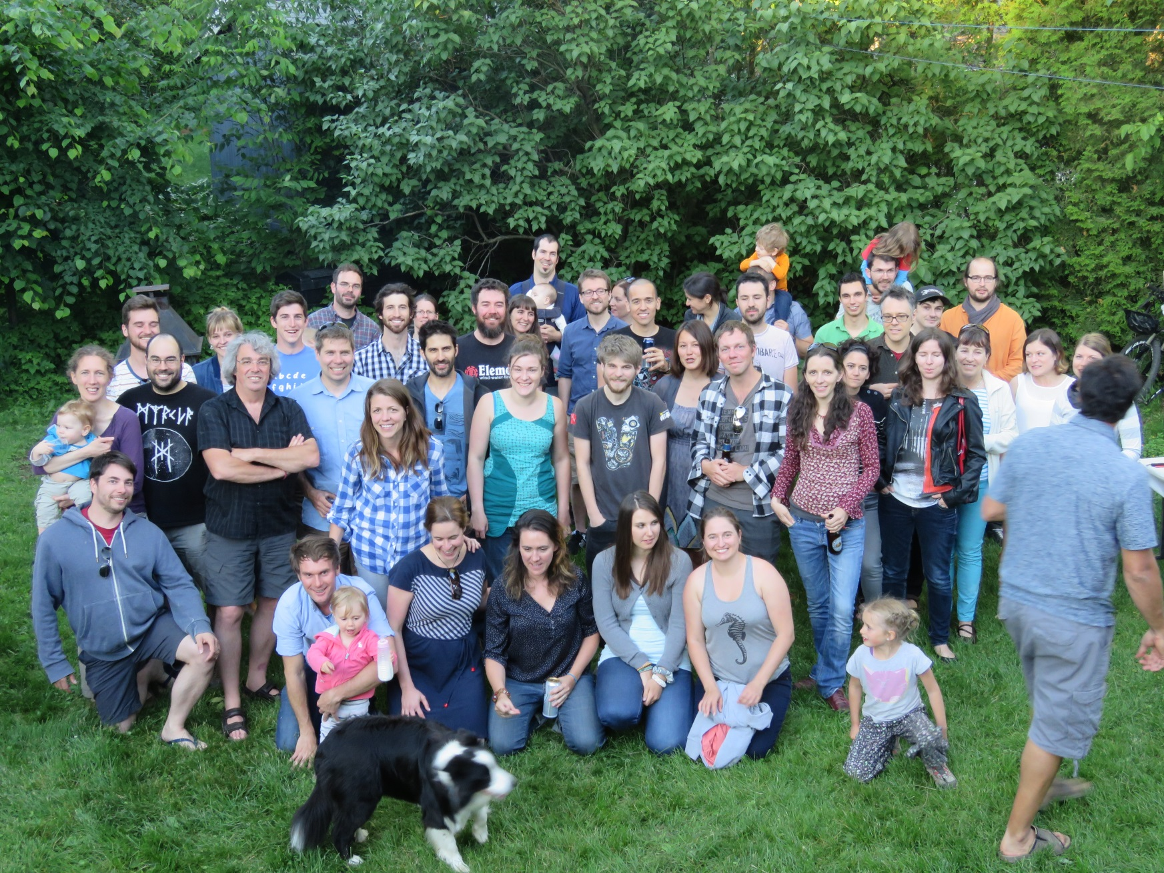

Louis Bernatchez’s lab
@LaboBernatchez

Slide 2
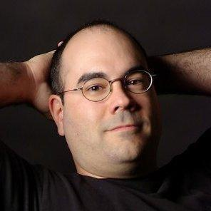
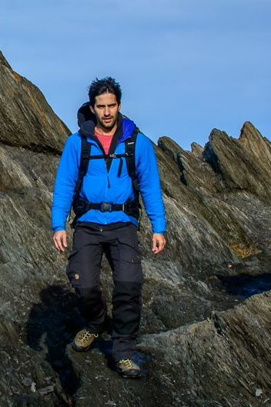


Louis Bernatchez’s lab
Eric Normandeau (Bioinformatician)
Laura Benestan (PhD candidate)
Thierry Gosselin (Post-doc researcher)
@LaboBernatchez

Slide 3
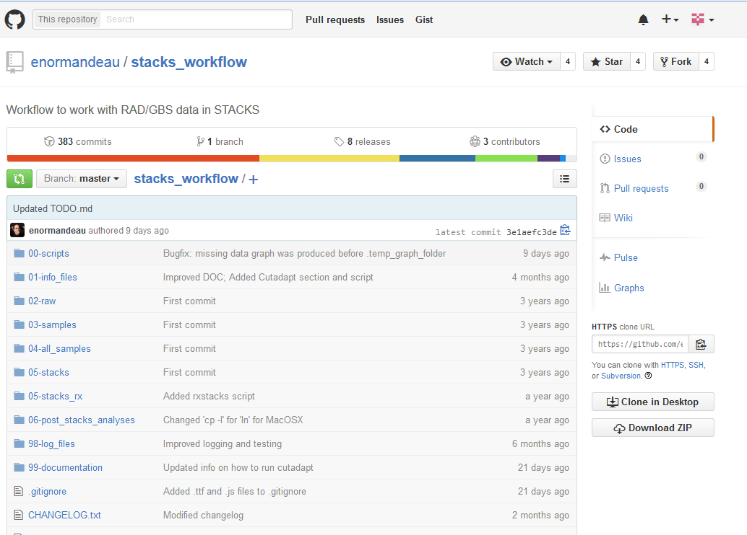
Workflow to work with RAD/GBS data in STACKS
https://github.com/enormandeau/stacks_workflow
Notes:
WARNING! will not work properly with STACKS versions older to v1.30 since the minor allele counts in the VCF file created by STACKS were not reported properly at that time

Slide 4
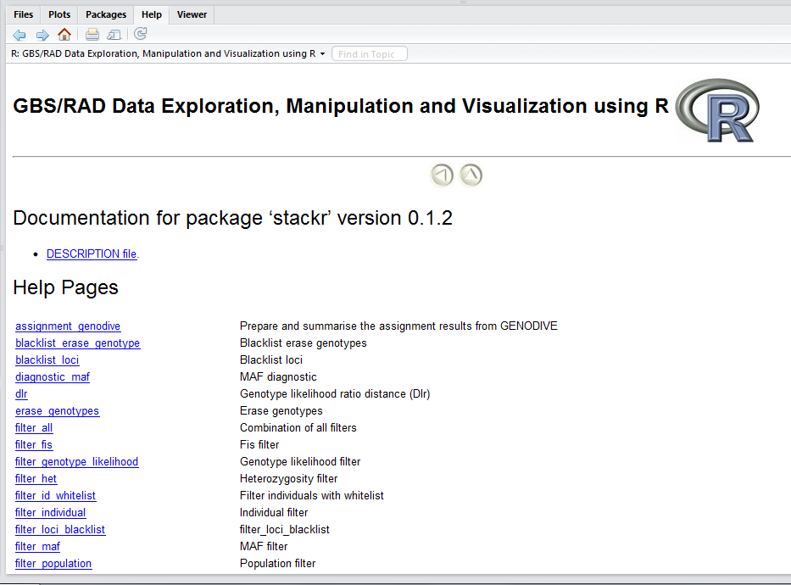

stackr: a R Package for the Analysis of GBS/RAD Data
https://github.com/thierrygosselin/stackr
Thierry Gosselin
Notes:
Use stackr to:
Read and modify batch_x.sumstats.tsv and batch_x.haplotypes.tsv files
Transform the VCF file, batch_x.vcf, into a tidy format to visualise and filter summary statistics within R
Filters genetic markers based on: coverage (read depth, REF and ALT allele depth), genotype likelihood, number of individuals, number of populations, minor allele frequency (local and global), observed heterozygosity and inbreeding coefficient (Fis)
View distributions of summary statistics and create publication-ready figures
Convert data into genepop, genind and gtypes object for easy integration with adegenet, strataG, hierfstat, pegas and poppr
Impute GBS markers without a genetic map using Random Forest within the haplo2genepop, haplo2genind, haplo2gtypes and haplo2colony functions

Slide 5
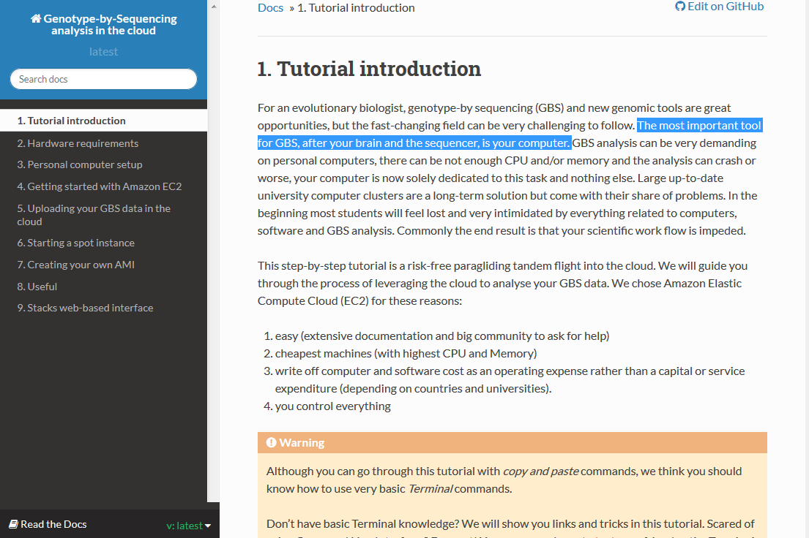
Genotype by Sequencing analysis in the cloud
GBS Tutorial
http://gbs-cloud-tutorial.readthedocs.org/en/latest/

